Slide 1
Community Corrections Partnership (CCP) September 12, 2018

Slide 2
Demographic Information
Probation Department
Jennifer McDermott, Project Manager
Earl Montilla, Supervising DPO
Katie Ward, Social Services Manager
Agustina Simms, Supervising DPO
Sheriff’s Office
Brad Dewall, Captain
Health and Social Services
Andrew Williamson, M.H. Services Manager

Slide 3
Probation Population Demographics
Includes all adults under the jurisdiction of Probation within the Quarter, not a population snapshot
April – June 2018
Grant Type | PRCS | 1170 | Formal
Age (Average) | 38.2 | 41.2 | 35.5
LS/CMI (Average) | 27.3 | 25.6 | 19.7
Grant Type | PRCS (439) | % of Population | 1170 (112) | % of Population | Formal (2,787) | % of Population
Male | 410 | 93% | 78 | 70% | 2157 | 77%
Female | 29 | 7% | 34 | 30% | 630 | 23%
African American | 196 | 45% | 35 | 31% | 896 | 32%
Caucasian | 131 | 30% | 53 | 47% | 999 | 36%
Hispanic | 84 | 19% | 15 | 13% | 646 | 23%
Other | 28 | 6% | 9 | 8% | 246 | 9%

Slide 4
Probation Population City of Residence
Includes all adults under the jurisdiction of Probation within the Quarter, not a population snapshot
April – June 2018
Grant Type/City | PRCS (438) | 1170 (112) | Formal (2,787) | Total (3337)
Benicia | 5 | 1 | 53 | 59
Fairfield | 59 | 13 | 507 | 579
Rio Vista | 2 | 0 | 27 | 29
Vacaville | 41 | 22 | 387 | 450
Dixon | 6 | 2 | 69 | 77
Vallejo | 106 | 19 | 718 | 843
Suisun City | 12 | 3 | 119 | 134
Transient | 124 | 21 | 214 | 359
Homeless | 25 | 3 | 57 | 85
Other/Outside County | 32 | 26 | 562 | 620
None Listed | 27 | 2 | 74 | 103

Slide 5
Pretrial Services Legislative Update
Humphrey Decision
The CA Appellate Court’s decision on 1/25/2018 held that the Trial Court must inquire into and determine a defendant’s ability to pay and alternatives to money bail
If Court determines the defendant is unable to afford the amount of money bail necessary to ensure future appearances, it may set bail only upon a determination that no less restrictive alternative will satisfy that purpose
The Court must state findings and reasons on record for a valid order of detention
Impact of Humphrey Decision to Pretrial Services
Effective 2/1/2018 the Pretrial Services now screens all bailable felonies and registerable sex offenses and no longer screens misdemeanors with the exception of Domestic Violence and DUI’s
The Defendant Statement of Assets (CR-115) must be completed and attached to all Pretrial Services Reports submitted to the Court

Slide 6
Pretrial Services Legislative Update
Senate Bill 10 (SB10)
Effective October 1, 2019 Money Bail will be eliminated
Local Courts to establish Pretrial Assessment Services, either within the court system or via contract with a local agency
Court to decide release/detention at arraignment based on risk assessment and report completed by Pretrial Assessment Services

Slide 7
Pretrial Services Legislative Update
Impact of Senate Bill 10 (SB10) to Pretrial Services
Misdemeanor arrestees, with limited exceptions, will be booked and released within 12 hours without being assessed by Pretrial Assessment Services
Other arrestees will be assessed by Pretrial Assessment Services within 24 hours and assigned a risk level of low, medium or high via a validated pretrial risk assessment tool
Those scoring low, with limited exceptions, shall be released by Pretrial Assessment Services on their own recognizance prior to arraignment
Those scoring medium, with limited exceptions, shall be released or detained pending arraignment according to standards established by the Judicial Council of CA and the local rule of court
Those scoring high or meeting specified criteria shall be held pending arraignment
Court to decide release/detention at arraignment based on risk assessment and report completed by Pretrial Assessment Services.

Slide 8
Pretrial Services Population Demographics
Total Number of Pretrial Decisions Made by the Court by Gender
Quarter 1: January – March 2018
Quarter 2: April – June 2018

Slide 9
Pretrial Services Population Demographics
Pretrial Decisions Made by the Court by Gender
Quarter 1: January – March 2018 (Blue)
Quarter 2: April – June 2018 (Red)
Pretrial Granted: Client released from custody on Pretrial Supervision
Pretrial Denied - ORR: Client released from custody on their own recognizance
Pretrial Denied – Detained: Release on Pretrial Supervision denied, Client remanded

Slide 10
Pretrial Services Population Demographics
Pretrial Decisions Made by the Court by Offense Level
Quarter 1: January – March 2018 (Blue)
Quarter 2: April – June 2018 (Red)
February 1, 2018, changes to the Pretrial Screening Criteria were implemented as a result of the Humphrey Decision
Prior to Humphrey Decision, Misdemeanors were screened and only a subset of Felonies (Non-Violent, Non-Serious, Non-Sex Offense) were screened
Post Humphrey Decision, all bailable Felonies are screened and a subset of Misdemeanors (Domestic Violence and DUI charges) are screened

Slide 11
Pretrial Services Population Demographics
Pretrial Decisions Made by the Court by Offense Level (not a population snapshot)
Quarter 1: January – March 2018
Quarter 2: April – June 2018
February 1, 2018, changes to the Pretrial Screening Criteria were implemented as a result of the Humphrey Decision
Prior to Humphrey Decision, Misdemeanors were screened and only a subset of Felonies (Non-Violent, Non-Serious, Non-Sex Offense) were screened
Post Humphrey Decision, all bailable Felonies are screened and a subset of Misdemeanors (Domestic Violence and DUI charges) are screened

Slide 12
Pretrial Services Population Demographics April – June 2018
Top 3 Felony (F) or Misdemeanor (M) Offenses by Court Decision
Pretrial Release Granted | Pretrial Denied Detained | Own Recognizance (ORR)
Assault & Battery (M) | Assault (F) | Drug Violations (M)
Drug Violations (M) | Assault & Battery (M) | Assault & Battery (M)
Theft (F) | Other Felony (F) | Probation or Parole Violation (M)
Pretrial Granted: Client released from custody on Pretrial Supervision
Pretrial Denied - ORR: Client released from custody on their own recognizance
Pretrial Denied – Detained: Release on Pretrial Supervision denied, Client remanded

Slide 13
Pretrial Services Population Demographics Quarter 1: January – March 2018 Quarter 2: April – June 2018
Pretrial Decisions Made by the Court by Race/Ethnicity
Percentages based on Total Court Decisions per Quarter
Quarter 1 Total Court Decisions: 313
Quarter 2 Total Court Decisions: 323
Notes:
Divisor is the total number of court decisions made (323 for Current Quarter/313 for last quarter)

Slide 14
Pretrial Services Population Demographics Quarter 1: January – March 2018 Quarter 2: April – June 2018
Pretrial Decisions made by the Court by the Top Three Cities
33%
Quarter 1 Total Court Decisions: 313
Quarter 2 Total Court Decisions: 323

Slide 15
Pretrial Services - Overview
 | January – March 2018 Q1 | April – June 2018 Q2
Number active on Pretrial supervision at beginning of quarter | 136 | 169
Number active on Pretrial supervision at end of quarter | 169 | 132
Number of Pretrial reports submitted to Court during quarter | 266 | 277
Number of new Pretrial supervision grants during quarter | 111 | 90
Total number of days spent under Pretrial supervision (For cases terminating during the quarter) | 10,495 | 19, 349
Average no. of days under Pretrial supervision (For cases terminating during the quarter) | 164 | 171
A defendant can have multiple court cases
A single court case can go through pretrial processing multiple times
A defendant may be counted more than once in the month if they have multiple, non-concurrent court cases
Court cases for a single defendant with the same court case status date will be considered concurrent and counted as one

Slide 16
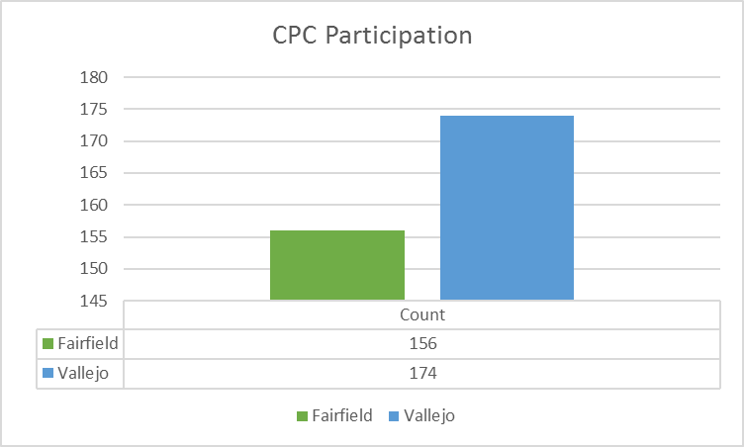
Probation Center for Positive Change
Includes all active participants of the CPC within the quarter,
not a population snapshot
April – June 2018

Slide 17
Centers for Positive Change
Highlights
Recognized 71 clients at completion ceremony on August 14th
Two new CPC supervisors, Crystal Riley and Agustina Simms
New Social Services Manager, Katie Ward, started at the end of May
Evidence-Based and Capacity Building
Careful selection of interventions and services that can be delivered with fidelity with an expectation of effectiveness
Promising or High rated with a direct effect on recidivism reduction
Train and Practice
Quality Assure
Drive data collection, analysis and repeat

Slide 19
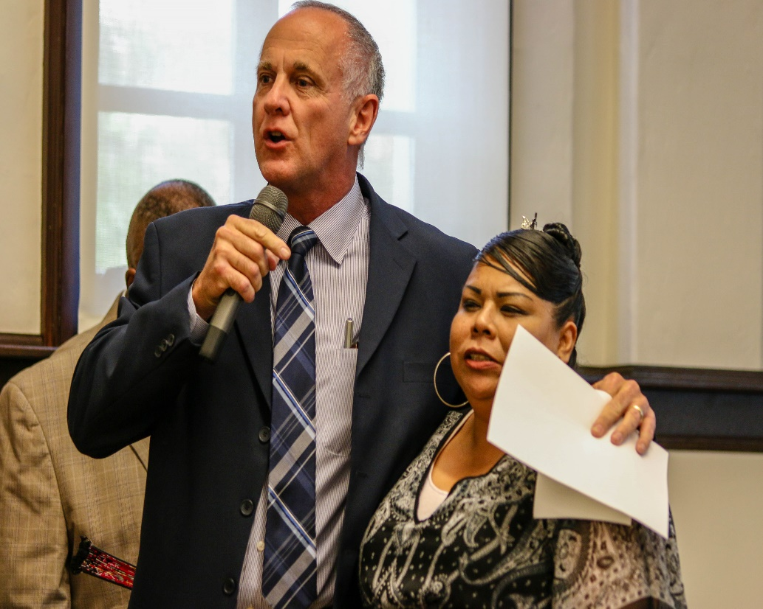

Slide 20
Demographic Information
Probation Department
Jennifer McDermott, Project Manager
Katie Ward, Social Services Manager
Agustina Simms, Supervising DPO
Sheriff’s Office
Brad Dewall, Captain
Renee Smith, Program Manager
Health and Social Services
Sandra Sinz, Deputy Director
Andrew Williamson, M.H. Services Manager

Slide 21
Centers for Positive Change
Partner Service Highlights
Healthright 360 expanded intensity of Matrix Substance Abuse Intensive Outpatient Programming to include family support, additional gender responsiveness, and higher dosage (refers to number of treatment hours). 110 clients participated in Matrix during the 4th quarter.
LCA Employment retention at the 90 day mark realized a 61% improvement, a result of expanding services to include a Job Retention Specialist.
Five Keys Charter Schools at Vallejo and Fairfield served 310 students during the 2017-2018 school year. Uniquely, about 25% of Five Keys students are not on Probation, rather they are family members or friends of clients seeking a safe place to earn their GED or diploma. 16 students graduated, earning High School diplomas and GEDs.

Slide 22
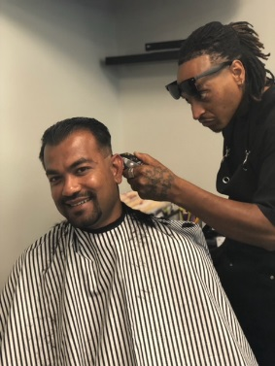
Centers for Positive Change
Community Engagement and Connection
Back to School Haircut Event
Late Night Basketball in collaboration with New Horizon and Friendship Missionary Baptist Church
Increased referrals for Medication Assisted Treatment service for opioid addiction
Quality Assurance – Quarter Snapshot (Q4 FY 17/18)
79 hours of quality assurance in multiple interventions and services
Individual Taped Sessions
Group Intervention Delivery
Case Study Review – team model
New Quality Assurance Coach, Tanya Hill, joined our team in June
Importance of QA to Program Fidelity and Outcomes

Slide 23
The best is to have a strong program implemented well
Thus one should optimally pick the strongest intervention that one can implement well
The effect of a well implemented weak program is as big as a strong program implemented poorly
Source: Adapted from Lipsey, 1997, 2005
Dennis, Michael. Presentation to Multnomah County. http://www.chestnut.org/LI/Posters/. November 2007.

Slide 24
Demographic Information
Probation Department
Jennifer McDermott, Project Manager
Katie Ward, Social Services Manager
Agustina Simms, Supervising DPO
Sheriff’s Office
Brad Dewall, Captain
Renee Smith, Program Manager
Health and Social Services
Sandra Sinz, Deputy Director
Andrew Williamson, M.H. Services Manager

Slide 25
Sheriff’s Office Statistics
09.12.18
*Data through June 30th, 2018
Captain Brad Dewall

Slide 26
Jail Population Trend October 1st, 2011 – June 30th, 2018 *This graph does not include daily bed lease inmate count
743
Notes:
This graph shows our in-custody daily inmate population from October 1st 2011 (the start of Public Safety Realignment) through June 30th 2018.
NOTE: This graph does not include any of the BED LEASE inmates.
*NO BED LEASE SINCE March 5th 2018

Slide 27
Realignment Percentage of Jail Population & Population Trends June 30th,2018
78.8% (586) | 21.2% (157)
Notes:
The pie chart (to the left) shows that the REALIGNMENT population accounted for 21.2% of the total Custody Division Jail Population on June 30th, 2018.
On June 30th , we had :
31 – 3056’s in custody accounted for 4.2% of our population (not including bed leases)
77 – 1170’s in custody accounted for 10.4% of our population (not including bed leases)
49 – PRCS’s in custody accounted for 6.6% of our population (not including bed leases)
The GRAPH to the right shows the population trend for each those populations: Parolees (3056’s) are represented by the BLUE line, the 3-Non Population (1170h PC’)s are represented by the RED line and the Post Release Community Supervision (PRCS’s) are represented by the GREEN line.

Slide 28
Sheriff Enforcement Team (SET) Compliance Checks through June 26th, 2018 (6 Month Snapshot)
Notes:
This slide shows the Sheriff’s Enforcement Team – Compliance Checks for the past 6 months.
On June 26th, 2018 The SET Team conducted a COMPLIANCE Sweep in the city of Fairfield & Suisun.
PRCS COMPLETED: 20
IN COMPLIANCE: 19
PRCS ARRESTS: 0
SANCTIONS/CRIM.COMPLAINT: 1
BAD ADDRESS: 0
FOLLOW UP: 5

Slide 29
Sheriff’s Enforcement Team October 1, 2011 – June 26th, 2018
908 Fugitives
853 Arrested
55 Actively Seeking
Notes:
Of the 908 PRCS (Post Release Community Supervision) fugitives the SET Team has been tasked to locate.
853 – have be arrested….. while they are actively seeking 55 individual PRCS offenders.

Slide 30
Sheriff’s Office Program Services Update

Slide 31
Sheriff’s Office Program Services Update
Case Management Services
Healthright 360 Case Managers are fully integrated into Jail Programs system of care.
Working with WRAP, MIOCR and Prop 47 to coordinate Re-entry Case Management Services.
Five Keys Charter School—full service high school
Providing high school credits toward diploma across all three jails.
Providing Classroom based services at Claybank and Independent Study at Claybank, Stanton and JCDF.
5 High School Diploma’s this quarter.

Slide 32
Sheriff’s Office Program Services Update
Employment Readiness
LCA continues to provide Classroom style Employment Readiness Services at Claybank to Men and Women.
This quarter, 32 individuals who participated in employment skills in-custody arrived at the CPC for services. Of those, 16 found employment, 13 are still working and 6 received vocational training.
Mentally Ill Offender Crime Reduction Grant (MIOCR)
MIOCR Milestones Celebration occurred on June 15.
MH Collaborative Court is gearing up to start.
Proposition 47
A collaboration with H&SS, the Courts, Probation and the Sheriff. Expands the existing continuum of SUD services to include additional Detoxification, Residential Treatment, Sober Living Environments and

Slide 33
Sheriff’s Office Program Services Update
Transitional Housing.
Sheriff’s Office housing Prop 47 Coordinator.
Substance Abuse Treatment Services
A new contractor, Healthright 360, began providing services to both male and female inmates on June 18, 2018.
Services for Female Inmates
The jail continues to provide an array of gender responsive and trauma informed services for women through the WRAP Program.
Other Jail Program Services
Men & Women’s Parenting Programs (Child Haven)
Chaplain’s Services
Self Help Groups (AA/NA/Bridging the GAP)

Slide 34
Jail Program Data April 1 – June 30, 2018
Five Keys Demographics
Age
18-24: 58
25-45: 147
45+: 28
Ethnicity
African American: 70
Latino: 26
Caucasian: 86
Multiracial: 36
Asian: 2
API: 2
Filipino: 2
Gender
Female: 31
Male: 202

Slide 35
Jail Program Data April 1 – June 30, 2018
Healthright 360 Case Management
Total Served = 228
Healthright 360 Case Management
Age

Slide 36
Jail Program Data April 1 – June 30, 2018
Healthright 360 Case Management
Ethnicity

Slide 37
Jail Program Data April 1 – June 30, 2018
WRAP Demographics
Age
21-29: 17
30-39: 33
40-49: 14
50-59: 8
60 and up: 2
Ethnicity
African American: 18
Latino: 12
Caucasian: 29
Mixed: 7
Native American: 3
API: 4
Romanian: 1
Gender
Female: 73
Transgender: 1

Slide 38
Jail Program Data April 1 – June 30, 2018
Employment Skills (LCA)
Total Served = 96 | CPC check in count = 32
Employment Skills Demographics
Age
15-25 years | 24
26-36 years | 39
37-47 years | 27
48+ years | 6
Ethnicity
African American | 35
Caucasian | 29
Latino | 16
Other | 16
Gender
Male | 69
Female | 27

Slide 39
Healthright 360 AOD Program Data June 18 - June 30, 2018

Slide 40
Healthright 360 AOD Program Data June 18 - June 30, 2018

Slide 41
MIOCR Program April 1, 2018 – June 30, 2018

Slide 42
MIOCR Program April 1, 2018 – June 30, 2018

Slide 43
MIOCR Program April 1, 2018 – June 30, 2018

Slide 44
Health and Social Services (HSS) Mental Health Services
Andrew Williamson, M.H. Services Manager

Slide 45
Health & Social Services (HSS) Mental Health Services
Integrated Care Clinics (ICC) provide initial mental health assessments and ongoing psychiatry services including monitoring medication, crisis intervention as needed, and light case management. The target population is Seriously Mentally Ill (SMI) adults who are appropriate for medication monitoring services. ICC sites are located in Fairfield, Vallejo and Vacaville.
Non-Forensic Mental Health services may include private providers from the network of care, Full Services Partnerships (FSP) programs, or Case Management Programs.
Forensic Assertive Community Treatment (FACT) is a Full Service Partnership (FSP) Program specializing in the provision of intensive mental health services to Seriously Mentally Ill (SMI) offenders. Services include intensive case management, individual and group therapy, psychiatry and medication monitoring, individual rehab, and crisis intervention as needed. FACT works closely with Probation and the Courts to monitor clients’ progress.
Exodus Crisis Stabilization Unit (CSU) provides crisis intervention for clients in acute crisis requiring further assessment for hospitalization. Additionally the CSU currently provides urgent medication refill services for clients at risk of hospitalization.
Crisis Residential Treatment (CRT)* facility geared to be a step down from hospital settings and can be used to prevent hospitalization. Clients placed at CRT must be Seriously Mentally Ill and at imminent risk of destabilization without this support.
Inpatient/Hospital facilities are used to stabilize clients who have become a danger to themselves, others, or are gravely disabled.

Slide 46
Health & Social Services (HSS) Mental Health Services
Probationers receiving Mental Health Services
(314 open cases)
April – June 2018

Slide 47
AB109 Mental Health Utilization

Slide 48
Health & Social Services (HSS) Substance Abuse Services
Behavioral Health Assessment Team (BHAT) assesses for acuity and level of care for substance using citizens of Solano County who are eighteen and older.
Outpatient Substance Abuse (SA) Treatment is substance abuse treatment by a local provider, based on assessment. A typical program includes three 90 minute groups per week, an individual session and urine testing.
Detox services are available 24 hours per day every day of the year and may last up to 15 days per episode.
Residential Substance Abuse (SA)Treatment is for clients with multiple, serious needs (e.g. housing and support network) in addition to uncontrolled substance use may be authorized for residential treatment in which the client lives in the treatment facility for a period up to six months.

Slide 49
AB109 Substance Abuse Utilization

Slide 50
Results First Initiative Update
Jennifer McDermott, Probation

Slide 51
Data Reporting Contract
Chief Hansen, Probation

Slide 52
BSCC Update
Donna Robinson, Probation
Renee Smith, Sheriff’s Office

Slide 53
Closing Comments

